Slide 1
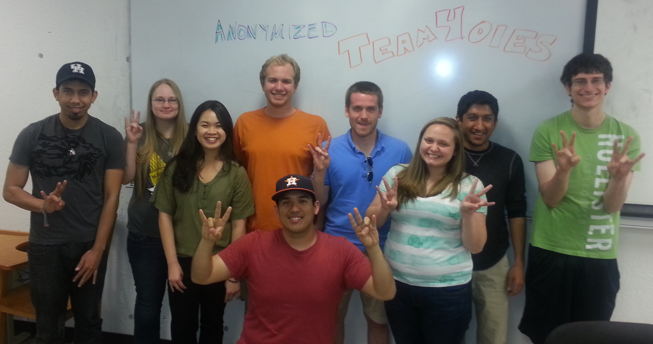
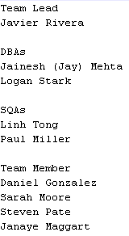
TEAM4OIES Online International EVAR System (ANONYMIZED Long Term Follow up EVAR Database) PRESENTATION Spring 2015
TEAM4OIES
ANONYMIZED

Slide 2
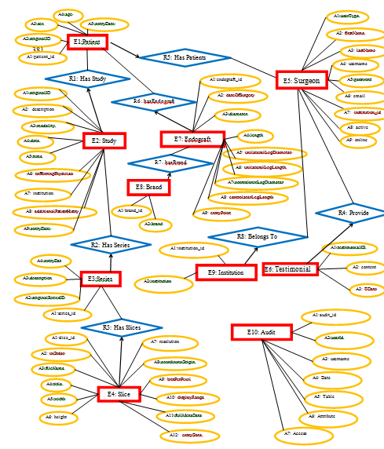
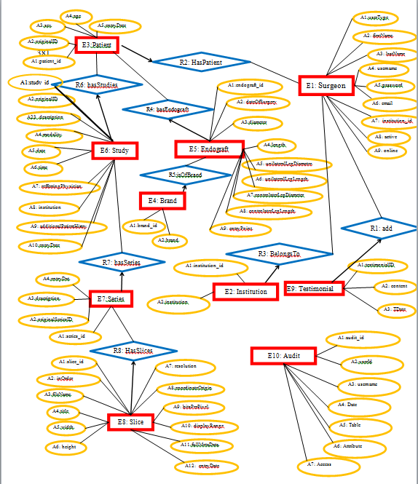
TEAM4OIES Online International EVAR System DATABASE BACK END
COPY AND PASTE
ERD:
# of Es: 10
# of Rs: 8
# of Vs: 1
# of Ts: 1
# of Ds: 18
# of Cs: 12

Slide 3
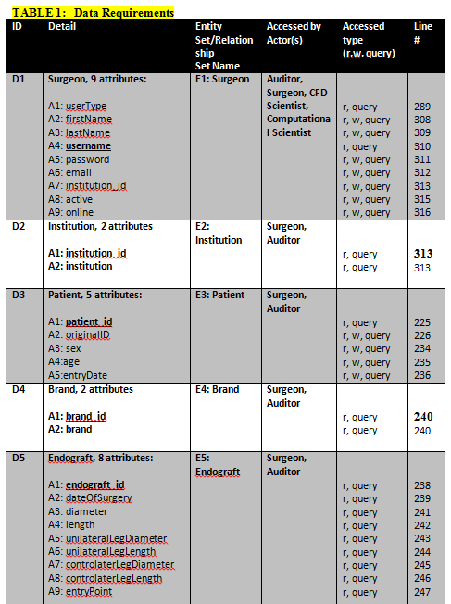
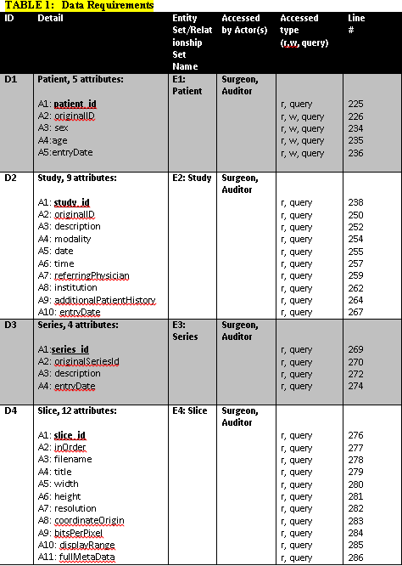
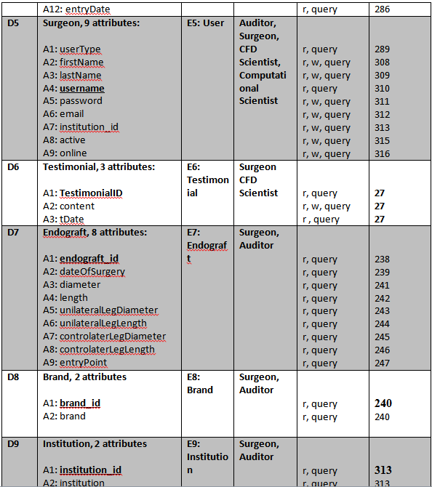
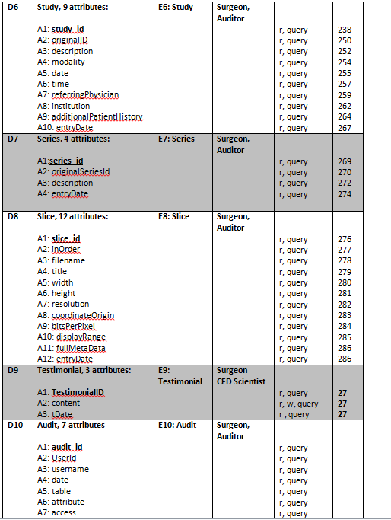
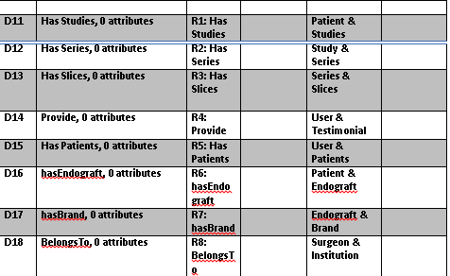
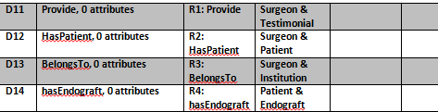
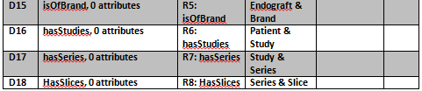
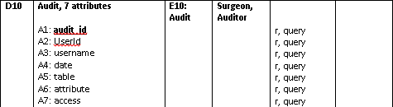
TEAM4OIES Online International EVAR System (ANONYMIZED Long Term Follow up EVAR Database) PRESENTATION Spring 2015
DRS: T1: Data Requirements

Slide 4
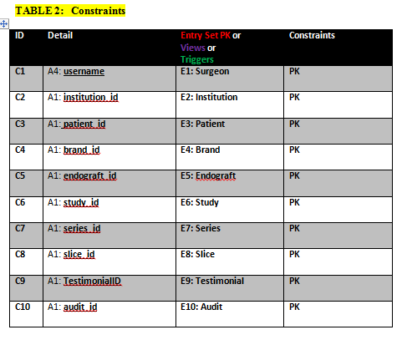
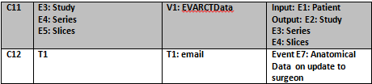
TEAM4OIES Online International EVAR System (ANONYMIZED Long Term Follow up EVAR Database) PRESENTATION Spring 2015
T2: Constraints

Slide 5
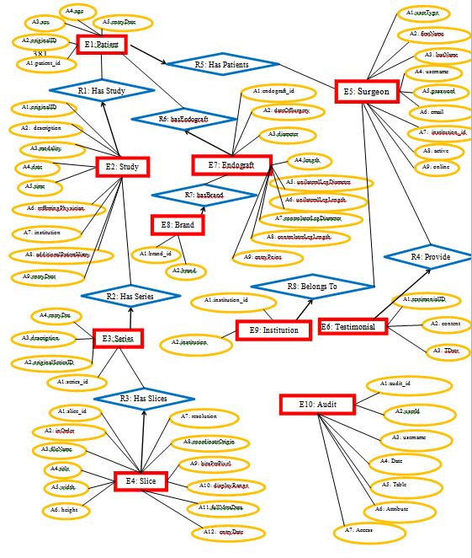
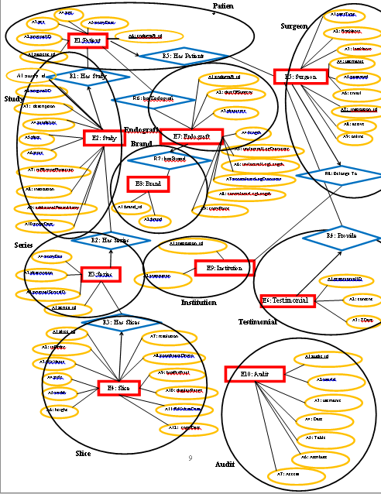
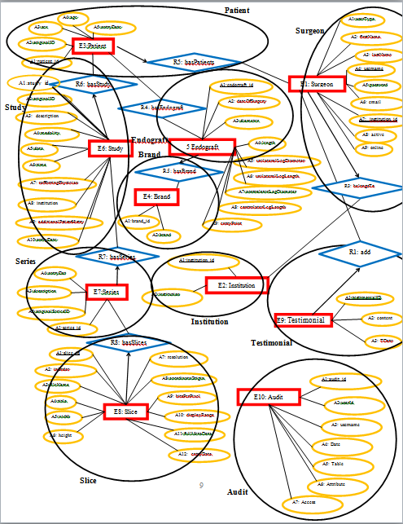
TEAM4OIES Online International EVAR System (ANONYMIZED Long Term Follow up EVAR Database) Data Design – Relational Model

Slide 6
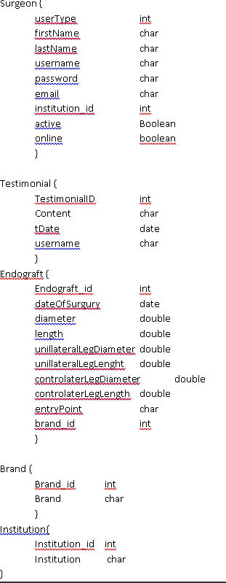
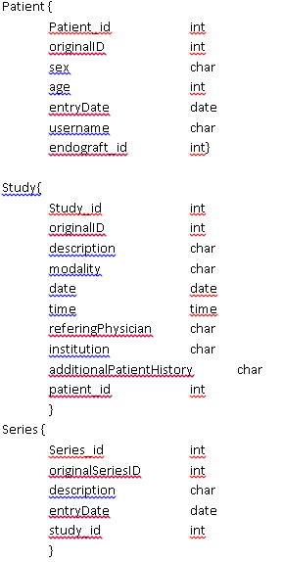
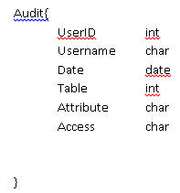
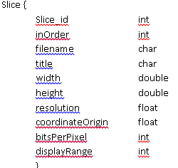
TEAM4OIES Online International EVAR System (ANONYMIZED Long Term Follow up EVAR Database)

Slide 7
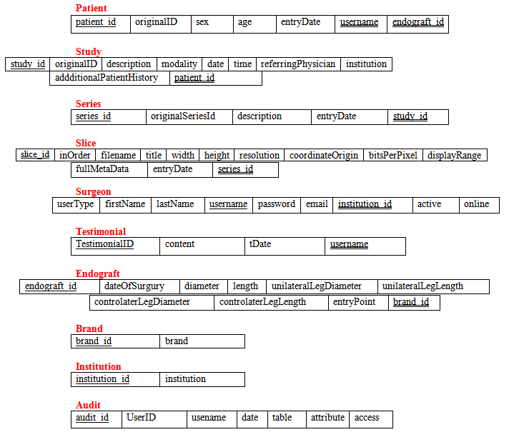
TEAM4OIES Online International EVAR System (ANONYMIZED Long Term Follow up EVAR Database) PRESENTATION Spring 2015
Relational Model: 3NF

Slide 8
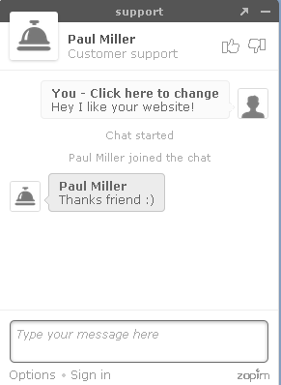
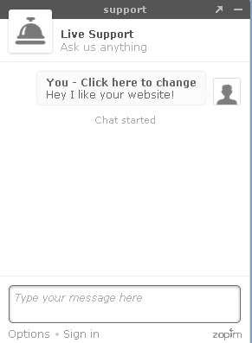
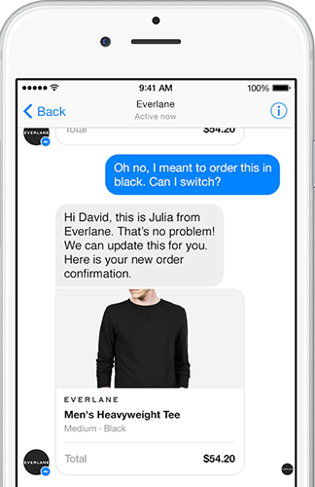
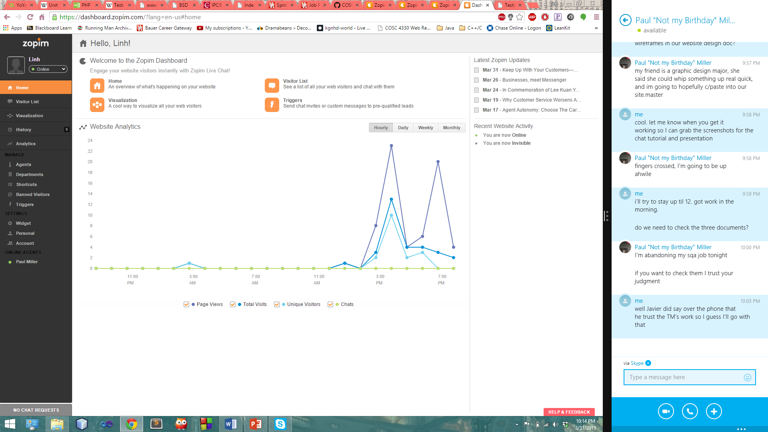
TEAM4OIES Online International EVAR System (ANONYMIZED Long Term Follow up EVAR Database)
FEATURES
Tracks and monitors visitors
Works on mobile devices
Easy integration with other tools/services
Example TIME!!!

Slide 9
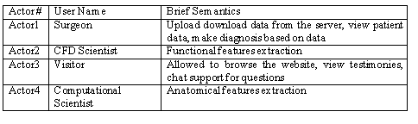
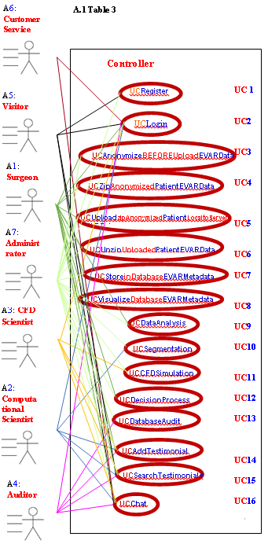

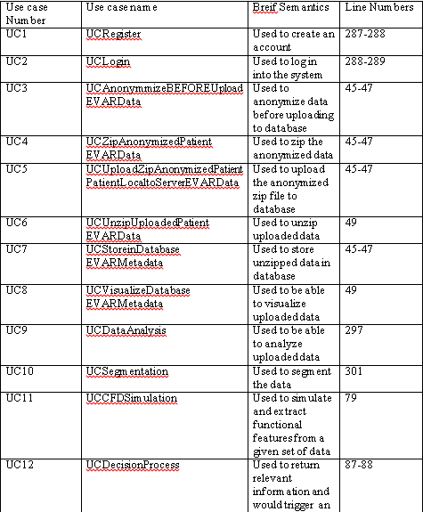
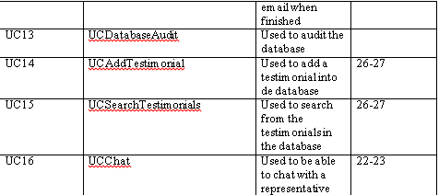
TEAM4OIES Online International EVAR System (ANONYMIZED Long Term Follow up EVAR Database) Business Modeling: UML USE CASE Model

Slide 10
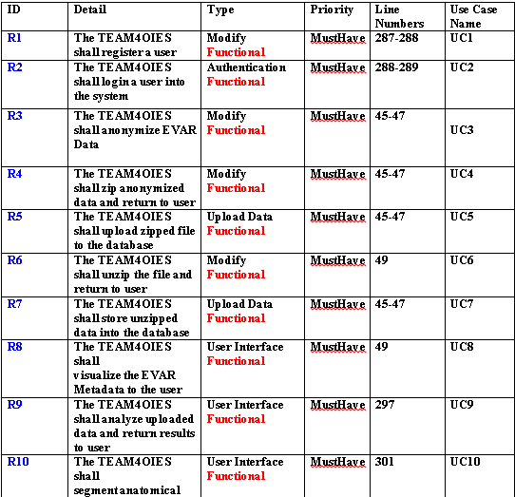
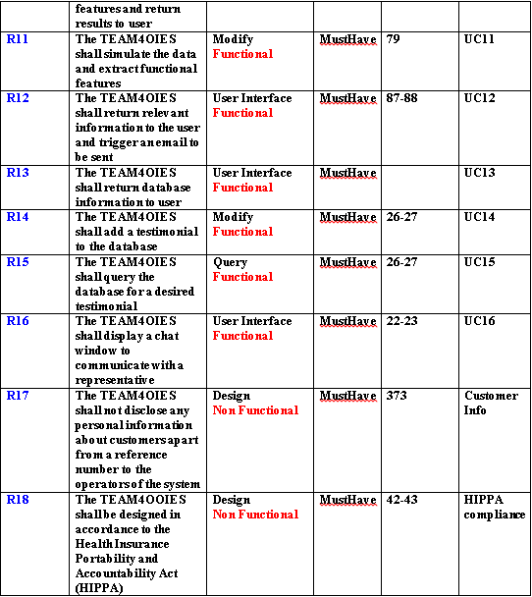
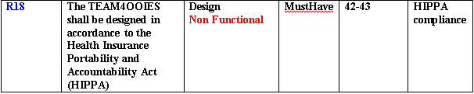
TEAM4OIES Online International EVAR System (ANONYMIZED Long Term Follow up EVAR Database) Contract: Software Requirements Specification

Slide 11
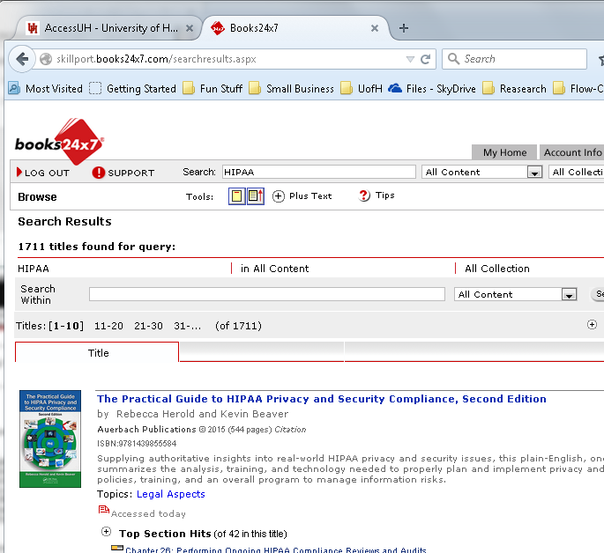
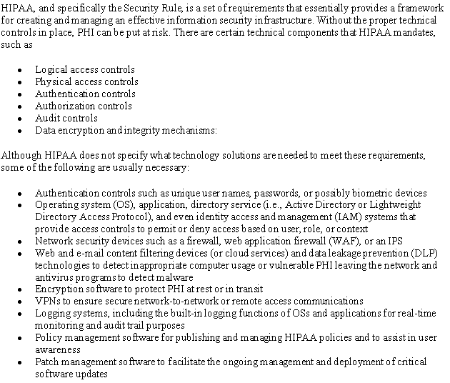

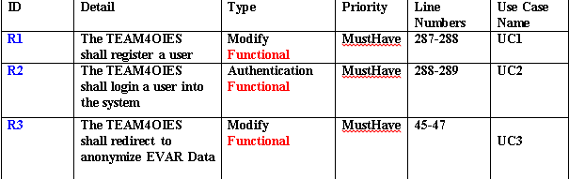
TEAM4OIES Online International EVAR System (ANONYMIZED Long Term Follow up EVAR Database)

Slide 12
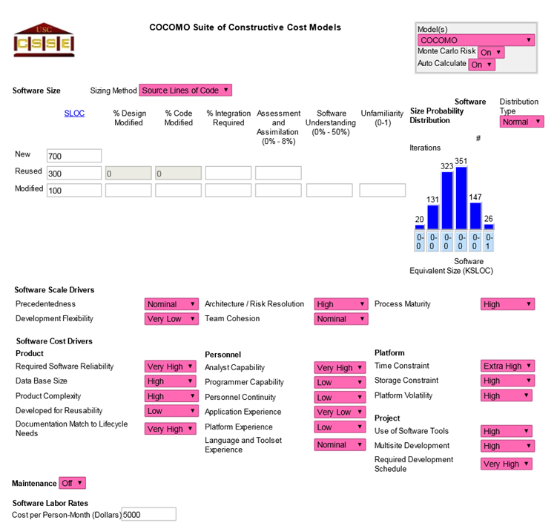
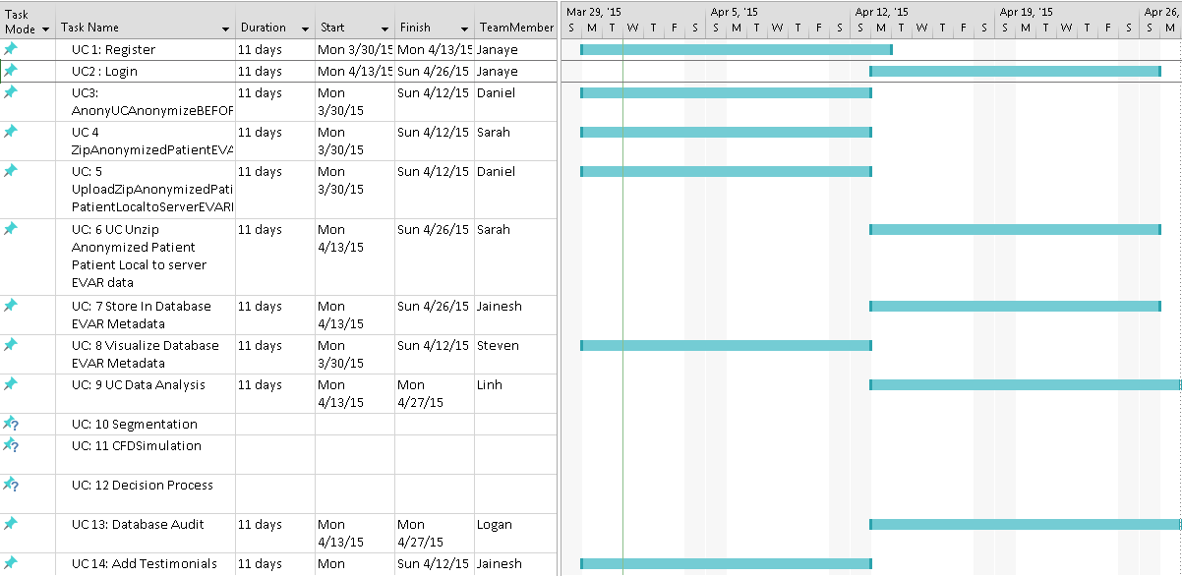
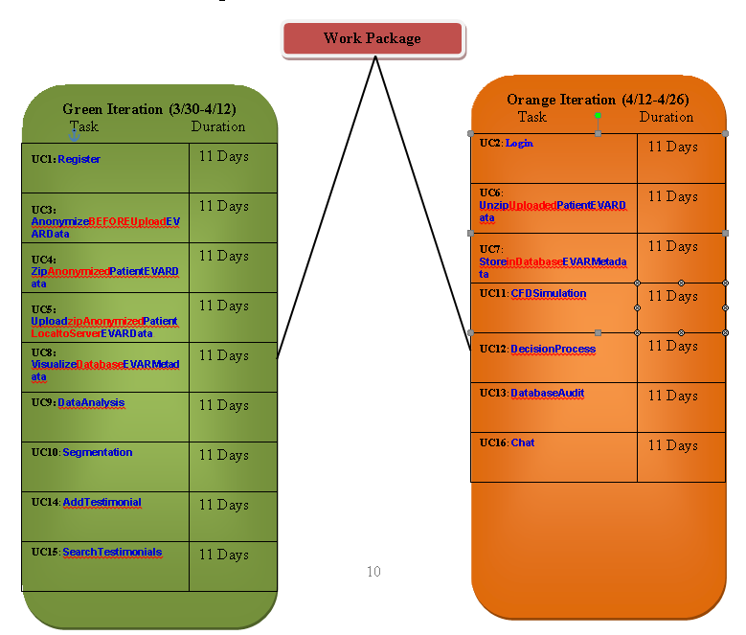
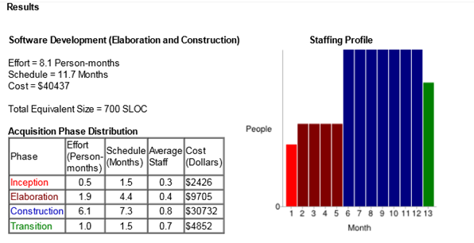
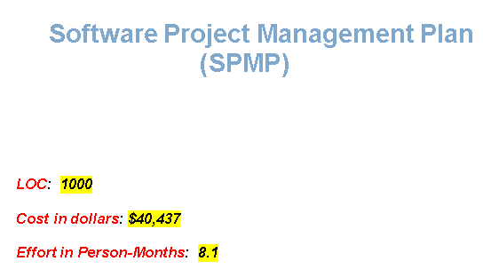
TEAM4OIES Online International EVAR System (ANONYMIZED Long Term Follow up EVAR Database) Software Project Management Plan

Slide 13
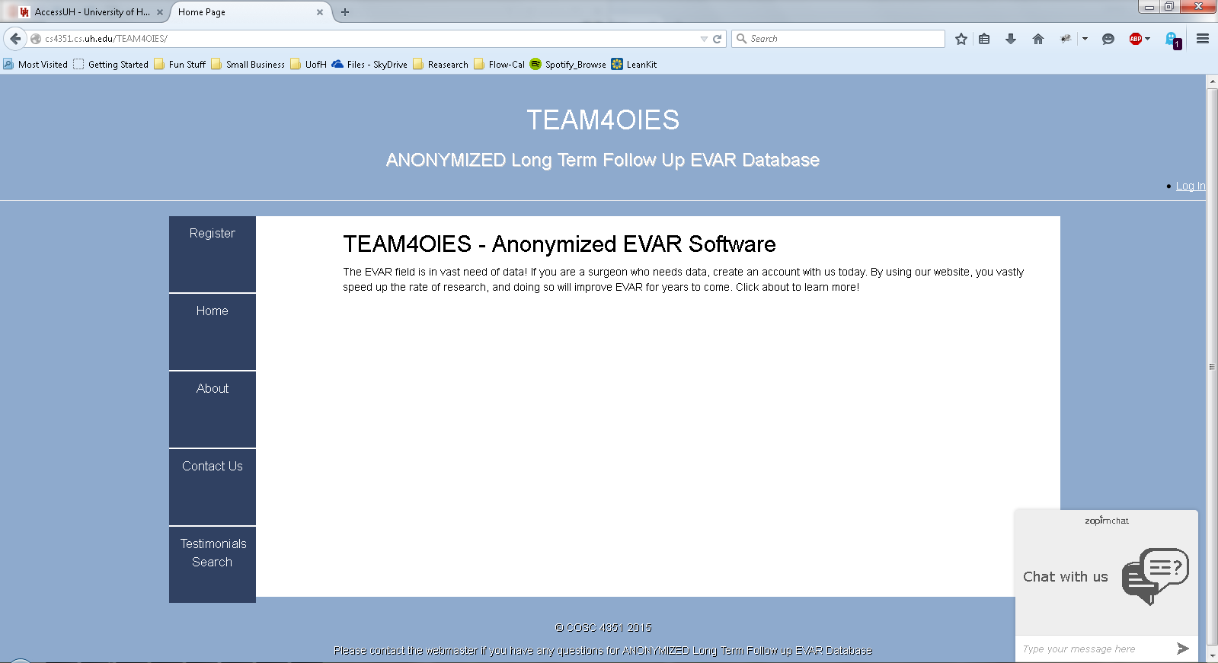
TEAM4OIES Online International EVAR System (ANONYMIZED Long Term Follow up EVAR Database)

